Slide 1
K-means
clustering

Slide 2
K Means
clustering - automatically grouping similar objects to the same groups.
Unsupervised learning refers to another class of algorithms that try to find the patterns in the data without any explicit labeling.
clustering is a form of learning by observation, rather than learning by examples.
distance-based method

Slide 3
IDEA
The objects (data points) within a particular cluster has to be very similar to the other objects (in that cluster) i.e. the within-cluster homogeneity has to be very high
but on the other hand, the objects of a particular cluster have to be as dissimilar as possible to the objects present in other cluster(s).

Slide 4
K-Means
K-Means falls under the category of centroid-based clustering.
A centroid is a data point (imaginary or real) at the center of a cluster.
Centroid-based clustering is an iterative algorithm in which the notion of similarity is derived by how close a data point is to the centroid of the cluster.

Slide 5
how k-means works
The process begins with k centroids initialized at random.
These centroids are used to assign points to its nearest cluster.
The mean of all points within the cluster is then used to update the position of the centroids.
The above steps are repeated until the values of the centroids stabilize.

Slide 6


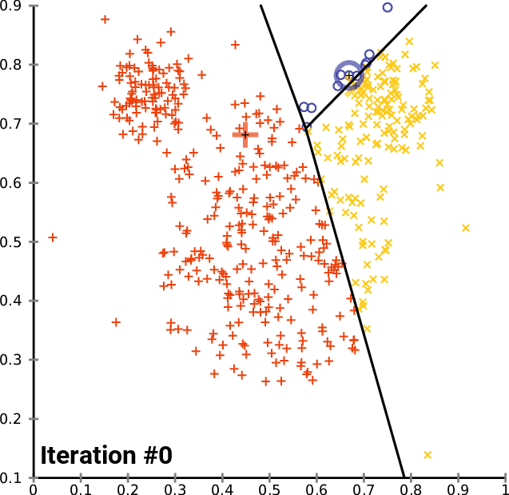

Slide 7
subscribe
https://www.youtube.com/watch?v=4b5d3muPQmA

